Slide 1
4B Adventurers
Vocabulary: character adjectives
Grammar: Past Perfect
Review: Past simple

Slide 2
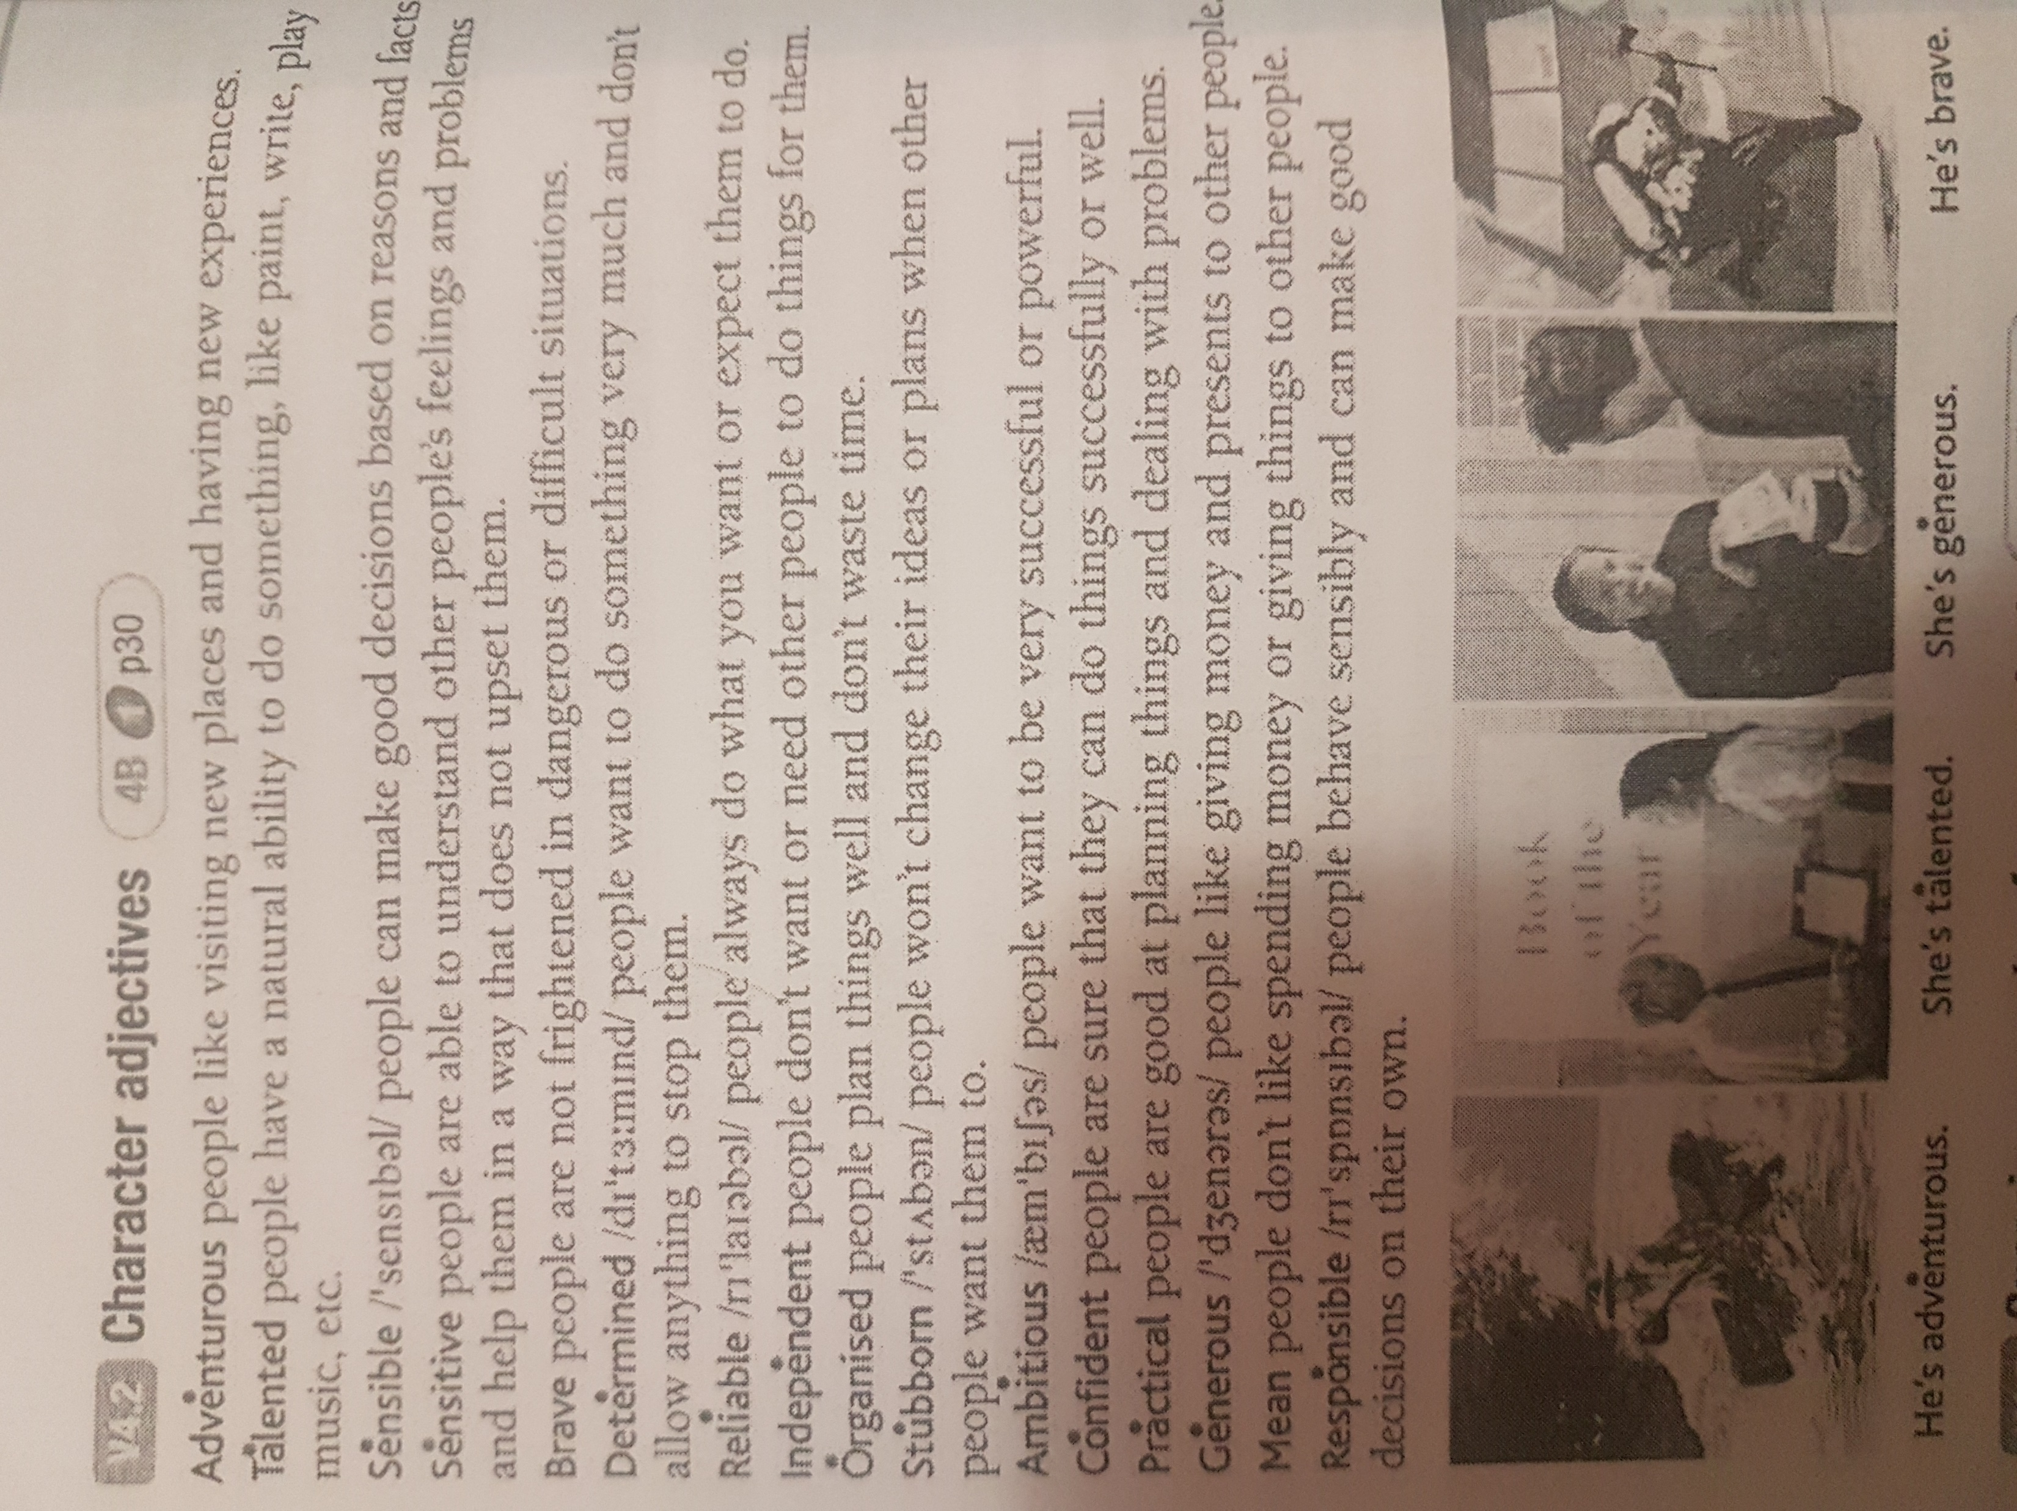
Adventurers
Please, open your books, p. 30 and
do exercise 1
Please, find on the right help with
new vocabulary:

Slide 3
Please, try to complete the table with the names and dates in exercise 2, p30.
Check your answers on p141.
How many did you get right?
Who are the women in photosA-C?

Slide 4
Listen to two TV producers, Beth and Luke, discussing a new TV series. Answer these questions. 1. What is Beth’s new TV series aboout? 2. Who is the first programme about? 3. Why didn’t this person become famous? 4. Where did Beth get the idea for the series? 5. What did Hariet do in 1911? 6. When did she arrive in England? 7. Why ddidn’t she fly on the Monday? 8. Did she know she was in France when she landed? 9. When and how did she die?

Slide 5
Past Perfect
We use the past perfect simple (had + past participle) to talk about time up to a certain point in the past.
She'd published her first poem by the time she was eight.
We can use the past perfect to show the order of two past events. The past perfect shows the earlier action and the past simple shows the later action.
When the police arrived, the thief had escaped.
We can also use the past perfect followed by before to show that an action was not done or was incomplete when the past simple action happened.
They left before I'd spoken to them.
We often use the adverbs already (= 'before the specified time'), still (= as previously), just (= 'a very short time before the specified time'), ever (= 'at any time before the specified time') or never (= 'at no time before the specified time') with the past perfect.
For more information on Past Perfect, please watch the following video
https://www.youtube.com/watch?v=X-pLTIafYWM&feature=emb_title

Slide 6
Past Perfect
1. I _____________ (study) Japanese before. 2. She _____________ (bake) a lot before she _____________ (open) her shop. 3. We _____________ (have) a lot of trouble because we _____________ (lose) our passports. 4. Brian _____________ (know) many people at the club because he _____________ (be) there many times. 5. They _____________ (study) English before they _____________ (move) to Canada. 6. You _____________ (enjoy) the movie because you _____________ (read) the book. 7. She really _____________ (like) him because he _____________ (help) her. 8. Amy _____________ (study) a lot before she _____________ (take) the test. 9. We _____________ (get) into the restaurant only because we _____________ (reserve) our places. 10. I _____________ (be) to India before 1986. 11. They _____________ (have) a lot of trouble before they finally _____________ (succeed). 12. Chris _____________ (own) that car for 5 years before he _____________ (sell) it. 13. Sharon _____________ (be) very sick until she _____________ (stop) eating junk food. 14. I _____________ (be) in Greece for 7 months before I _____________(move) to Spain. 15. You _____________ (cook) a lot, because you _____________ (be) so hungry.

Slide 7
Now, let’s practice Past Perfect. Could you please, do exercise 4/7/9, p31, Student’s book, and exercise 2/3/4/5, p.22, Workbook.
Thank you for your attention!
#Stay safe
#Stay home
Lecturer Ivana Milačić
ivana.milacic@udg.edu.me

