Slide 1
5 Into the future
5A Man or machine
1

Slide 2
Vocabulary
Move around easily – kretati se sa lakoćom
Build cars
Take over the world – preuzeti svijet
Recognize someone’s face –prepoznati nekoga
Look like someone – ličiti na nekoga

Slide 3
Vocabulary
Robot – robot
Do the house work – raditi kućne poslove
Clean the carpets – očistiti tepihe
Invention - izum
Feed the cat – hraniti mačku

Slide 4
Will for predictions
We use will to predict the future
Will is the same for all subjects: I/YOU/HE/SHE/IT/WE/YOU THEY will/won’t…
We often use Do you think… ? to make questions and the short answers to these questions are Yes I do/ No, I don’t. Do you think she will meet him? No, I don’t.
Examples:
I don't think he will come tonight. Do you think robots will take over the world? I predict that Congress will pass an anti-piracy law soon. If you ask him, he won’t (will not) probably give you a lift.

Slide 5
Will affirmative and question
Affirmative | He | will | be | here tomorrow.
 | Subject | WILL | Verb
Question | Will | he | be | here tomorrow?
 | WILL | Subject | Verb

Slide 6
May and Might
USES OF MAY / MIGHT
1. A FUTURE POSSIBILITY:
Where will you travel next year? I think I might visit Italy next year.
Are you watching the game on Sunday? I might not watch the football game on Sunday; I am too busy.
What will you eat for lunch? I may eat at McDonald’s for lunch.
I have a lot of homework to do, so I may not go to her party this weekend.
**Note: We do not use might or may with the main verb in a question.
If you want to ask a question with might / may, use:
How do you think the weather might be tomorrow?
Do you think it may rain tomorrow?

Slide 7
Be able to
 | subject | main verb be | adjective able | to-infinitive
+ | I | am | able | to drive.
- | She | is not | able | to drive.
 |  | isn't
? | Are | you | able | to drive?
We use be able to to express ability. "Able" is an adjective meaning: having the power, skill or means to do something. If we say "I am able to swim", it is like saying "I can swim". We sometimes use be able to instead of "can" or "could" for ability.

Slide 8
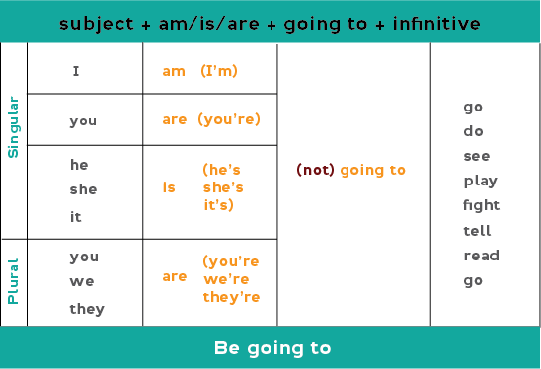
Be going to
We use be going to talk about personal plans I am going to play football tomorrow. I am not going to study today.

Slide 9
Be going to
going to for intention
We use going to when we have the intention to do something before we speak. We have already made a decision before speaking. Look at these examples:
Jo has won the lottery. He says he's going to buy a Porsche.
going to for prediction
We often use going to to make a prediction about the future. Our prediction is based on present evidence. We are saying what we think will happen. Here are some examples:
The sky is very black. It's going to snow.

Slide 10
5B Never too old
Vocabulary
Have a great/good/bad time
Get suntan – osunčati se
Spend time with someone
Live abroad – živjeti u inostranstvu
Spend time doing something
Take photos - fotografisati
Do a degree in Biology

Slide 11
Exercise number 5
A) 2 infinitive with to; 3 verb ing; 4 infinitive with to; 5 verb+ing
In the phrases 5a we talk about future plans
B) 1 I’m looking forward to… 2 I’m planning to…
3 I’m hoping to…
We can use I am looking forward to… : I’m looking forward to it/my holiday.
We can use I want and I’d love to talk about future plans and ambitions: I want to be famous. I’d love to travel around the world.

Slide 12
5C Out of this world
Vocabulary
Circular – kružno
A space ship –
Svemirski brod
Tourism - turizam
Earth - Zemlja
Revolve – okretati se
A screen - ekran
A rocket – raketa

Slide 13
Verbs and prepositions
Travel to Podgorica by car (by+means of transport)
Go on a trip. Ići na puzovanje.
Return to place you started. Vratiti se na mjesto od kojeg si počeo.
Pay an amount of money for something. Platiti određenu svotu novca...
Look for something you want to find. Tražiti nešto...
Sell something to people for an amount of money. Prodati nešto ljudima zaodređenu svotu novca.
Look out of a window. Pogledaj kroz prozor
Spend the amount of money on something. Potrošiti određenu sumu novca na nešto
Fly to a place. Letjeti negdje.
Talk about a topic. Pričati na neku temu.

Slide 14
Vocabulary
Trip – putovanje
Solar system – sunčev sistem
Moon –mjesec
Space – svemir
Island – ostrvo
Planet - planeta

Slide 15
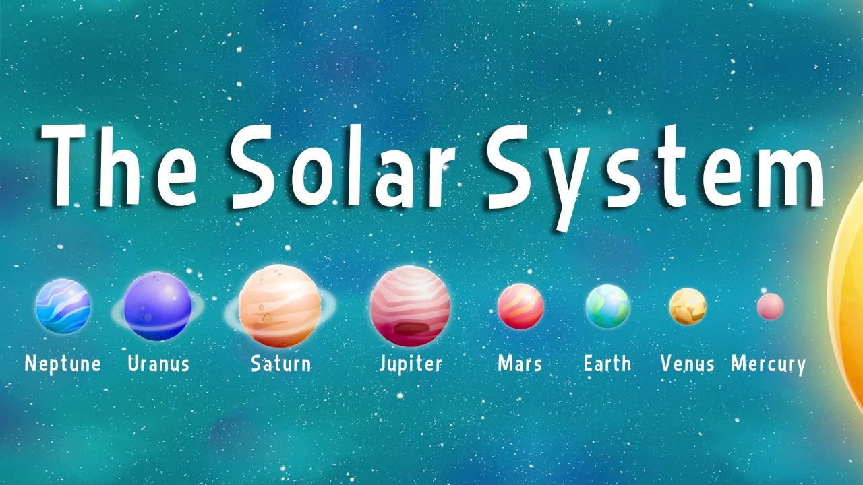
The Solar System

Slide 16
5D It’s for charity
Vocabulary
Paper - list papira - novine
A disco – disko
A karaoke night – noć karaoka
A quiz night – veče kviza
Machine –mašina
A concert – koncert

Slide 17
Offers, suggestions and requests
Shall I make some posters? Can I give you a hand? OFFERS I’ll help you, if you like.
Will you organise that? Could you give me a hand? MAKING REQUESTS Can you do that?
Yes that’d be great. Great, thanks a lot. RESPONDING TO OFFERS Yes, why not? No, I don’t worry.
Shall we start? Let’s decide who does that. MAKING SUGGESTIONS Why don’t we ask Steve?
Could you…? is more polite than Can you...? That’d be great= That would be great,

Slide 18
Review
Uraditi Review 5, strana 43

Slide 19
THANK YOU

