Slide 1
The Global Garden
Vocabulary: plants and gardens
Grammar: future verb forms; Future Continuous
Review: ways of comparing

Slide 2
Herbs- any plant with leaves, seeds, or flowers used for flavoring, food, medicine, or perfume.
"bundles of dried herbs"
-any seed-bearing plant which does not have a woody stem and dies down to the ground after flowering.
Seeds- the unit of reproduction of a flowering plant, capable of developing into another such plant.
Bulb-a rounded underground storage organ present in some plants, notably those of the lily family, consisting of a short stem surrounded by fleshy scale leaves or leaf bases, lying dormant over winter. "a tulip bulb“
Petals- each of the segments of the corolla of a flower, which are modified leaves and are typically colored.
Pollen- a fine powdery substance, typically yellow, consisting of microscopic grains discharged from the male part of a flower or from a male cone. Each grain contains a male gamete that can fertilize the female ovule, to which pollen is transported by the wind, insects, or other animals.
A pot- a rounded or cylindrical container, typically of metal, used for cooking.
"pots and pans hung from a rack"
-(verb) plant in a flowerpot.
"pot individual cuttings as soon as you see new young leaves"

Slide 3
Vine-a climbing or trailing woody-stemmed plant related to the grapevine.
Bush- a shrub or clump of shrubs with stems of moderate length.
"a rose bush"
-(especially in Australia and Africa) wild or uncultivated country.
"they have to spend a night camping in the bush"
- spread out into a thick clump.
"her hair bushed out like a halo"
Hedge-(noun) a fence or boundary formed by closely growing bushes or shrubs.
-(verb)a way of protecting oneself against financial loss or other adverse circumstances.
-surround with a hedge.
Lawn (noun)-an area of short, regularly mown grass in the garden of a house or park. “She was sitting in a deckchair on the lawn."
Root (noun)- the part of a plant which attaches it to the ground or to a support, typically underground, conveying water and nourishment to the rest of the plant via numerous branches and fibers. "the fungus attacks a plant's roots"
Branch (noun)-a part of a tree which grows out from the trunk or from a bough. "the branches of a tree"

Slide 4
Twig (noun)-a slender woody shoot growing from a branch or stem of a tree or shrub.
Anatomy
a small branch of a blood vessel or nerve.
READING
Have you ever heard about Eden Project?
Please about the Eden Project on page 40.and answer the questions in 2c)
Eden -1: PARADISE
2: the garden where according to the account in Genesis Adam and Eve first lived
3: a place of pristine or abundant natural beauty
Biome- a large naturally occurring community of flora and fauna occupying a major habitat, e.g. forest or tundra.
Listening
Listen to two friends, Emma and Diane. Tick the topics they talk about and then fill in the gaps in these sentences with two words.

Slide 5
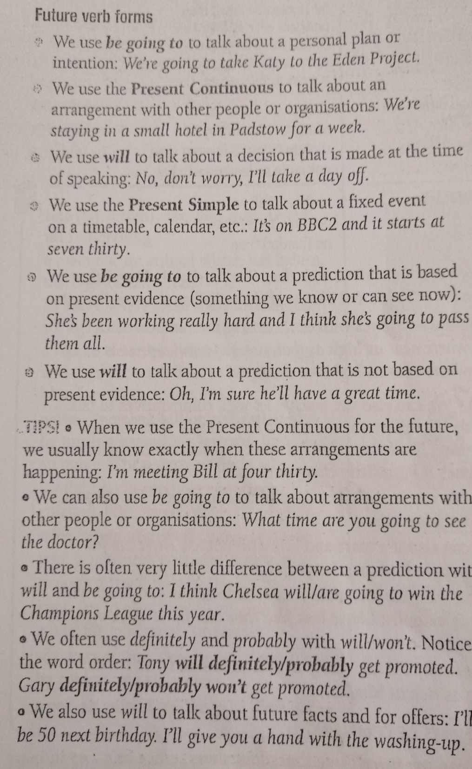

Slide 6
Future Continuous

Slide 7
Let’s practice future forms and future continuous.
Please look at the Help with grammar and try to do exercise 7 page 41.
Now listen and check.
For more information about the future forms please visit:
https://en.islcollective.com/english-esl-worksheets/search/Search+free+ESL+resources?grammar=future-tenses&level=upper-intermediate
Thank you fro your attention!
’’Stay Green, Stay Young’’ and Stay Healthy, Stay Home!

