Slide 1
12 Life experiences
12A World records
1

Slide 2
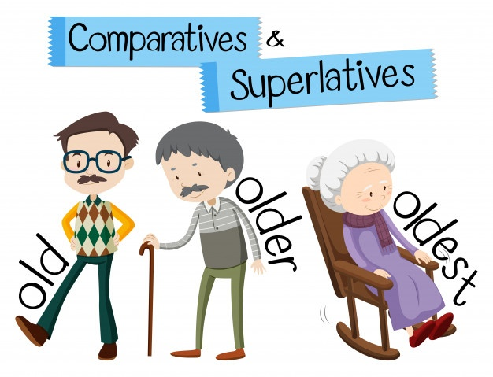
Comparatives and Superlatives
Adjectives with one syllable Usually if an adjective has only one syllable, we add 'er' to make the comparative form. We add 'est' to make the superlative form.clean → cleaner / cleanest
cold → colder / coldest
small → smaller / smallest
young → younger / youngest
tall → taller / tallest

Slide 3
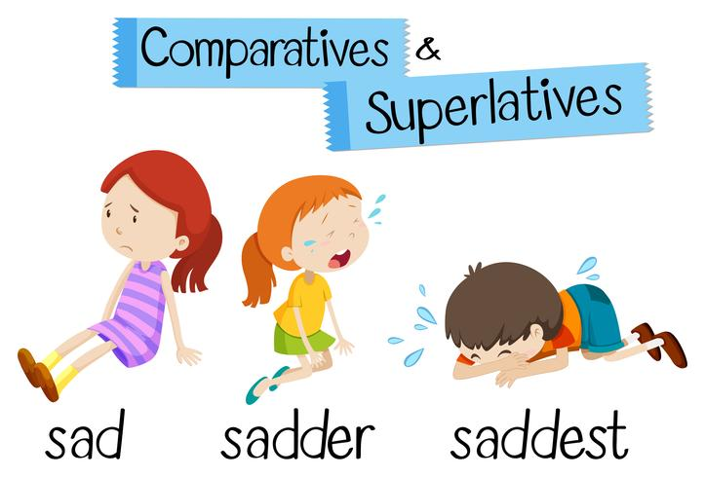
Comparatives and Superlatives
There are some spelling changes. If there is one vowel followed by one consonant at the end of the adjective, we often double the consonant.wet → wetter / wettest
big → bigger / biggest
hot → hotter / hottest
thin → thinner / thinnest
If the adjective ends in 'y', this often changes to 'i'.dry → drier / driest
If the adjective ends in 'e', we don't add another 'e', just 'r'.nice → nicer / nicest
large → larger / largest

Slide 4
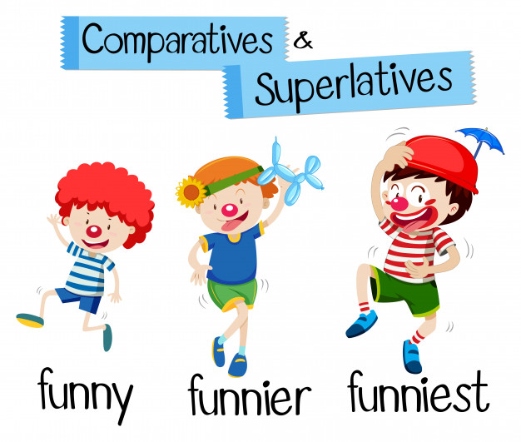
Comparatives and Superlatives
There are a few adjectives that we have to use 'more' or 'most' with, even though they only have one syllable. We CAN'T add 'er' or 'est'.fun → more fun / most fun (NOT funner / funnest)
real → more real / most real (NOT realer / realest)
right → more right / most right (NOT righter / rightest)
wrong → more wrong / most wrong (NOT wronger / wrongest)

Slide 5
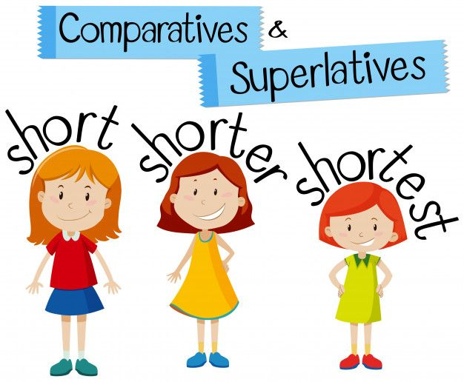
Comparatives and Superlatives
Adjectives with two syllables For adjectives with two syllables we generally use 'more' or 'most‘ careful → more careful / most careful
bored → more bored / most bored
But some two syllable adjectives can take 'er' or 'est'. It's also fine to use 'more' (for the comparative) or 'most' (for the superlative).clever → cleverer / cleverest
simple → simpler / simplest
narrow → narrower / narrowest
quiet → quieter / quietest

Slide 6
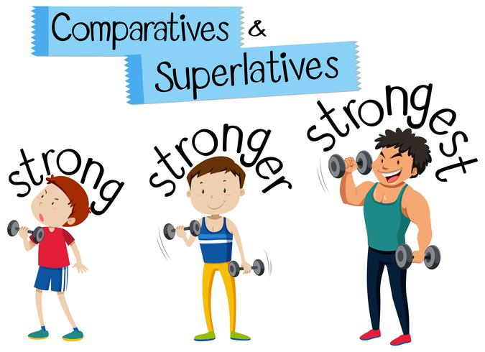
Comparatives and Superlatives
Adjectives with two syllables that end in 'y' usually can add 'er' or 'est' (y generally changes to i). It's also fine to use 'more' or 'most'.dirty → dirtier / dirtiest
pretty → prettier / prettiest
happy → happier / happiest
ugly → uglier / ugliest

Slide 7
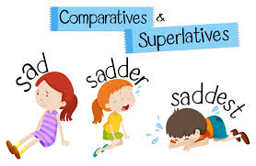
Comparatives and Superlatives
Adjectives with more than two syllables Adjectives with more than two syllables can only make their comparative by using 'more' and their superlative by using 'most‘ beautiful → more beautiful / most beautiful
intelligent → more intelligent / most intelligent
interesting → more interesting / most interesting
expensive → more expensive / most expensive

Slide 8
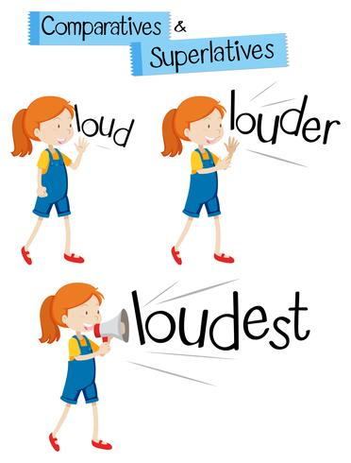
Comparatives and Superlatives
Irregular adjectives There are also some irregular adjectives. We just need to learn these forms good → better → best
bad → worse → worst
far → further → furthest
little → less → least
much → more → most

Slide 9
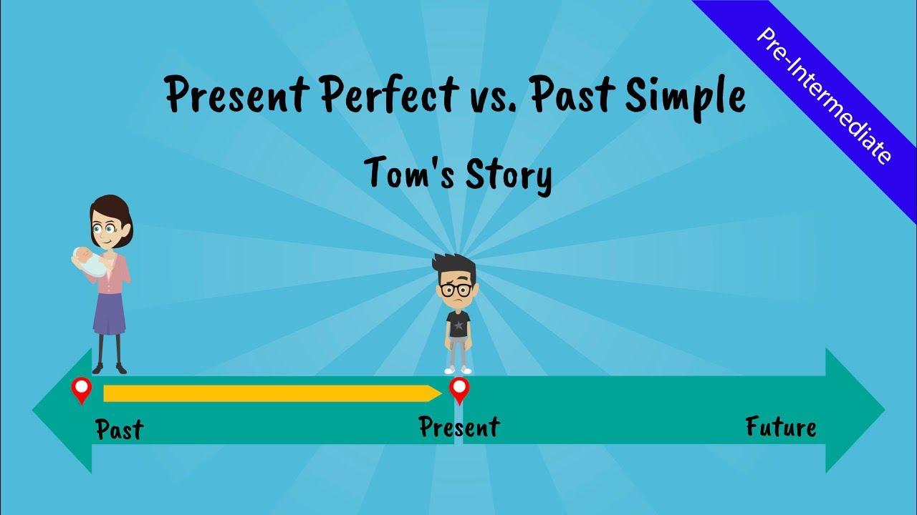
Present Perfect and Past Simple
Present Perfect VS Past Simple
Present Perfect | To talk about experiences in life until now, we don’t say when they happened.
Present Simple | We use it if we say when something happened
Examples | I’ve been to India. I went there two years ago.

Slide 10
Present Perfect positive
To make the positive present perfect tense, use:'have' / 'has' + the past participle
Positive | Positive Short Form
I have played | I've played
you have worked | you've worked
he has written | he's written
she has walked | she's walked
it has rained | it's rained
we have travelled | we've travelled
they have studied | they've studied

Slide 11
Present Perfect negative
Negative | Negative Short Form
I have not eaten breakfast today | I haven't eaten
you have not been to Asia | you haven't been
he has not seen the new film | he hasn't seen
she has not played tennis | she hasn't played
it has not snowed this winter | it hasn't snowed
we have not slept all night | we haven't slept
they have not tried the food | they haven't tried

Slide 12
Present Perfect questions
To make a question, put 'have' or 'has' in front of the subject:
'Wh' Questions
Where have I left my umbrella?
What have you done today?
Why has he gone already?
Where has she been in the UK?
Why has it rained so much this summer?
What have we done?
Where have they learned English before?
'Yes / No' Questions
Have I missed the bus?
Have you visited London?
Has he worked as a waiter before?
Has she met John?
Has it been cold this week?
Have we arrived too early?
Have they studied English grammar before?

Slide 13
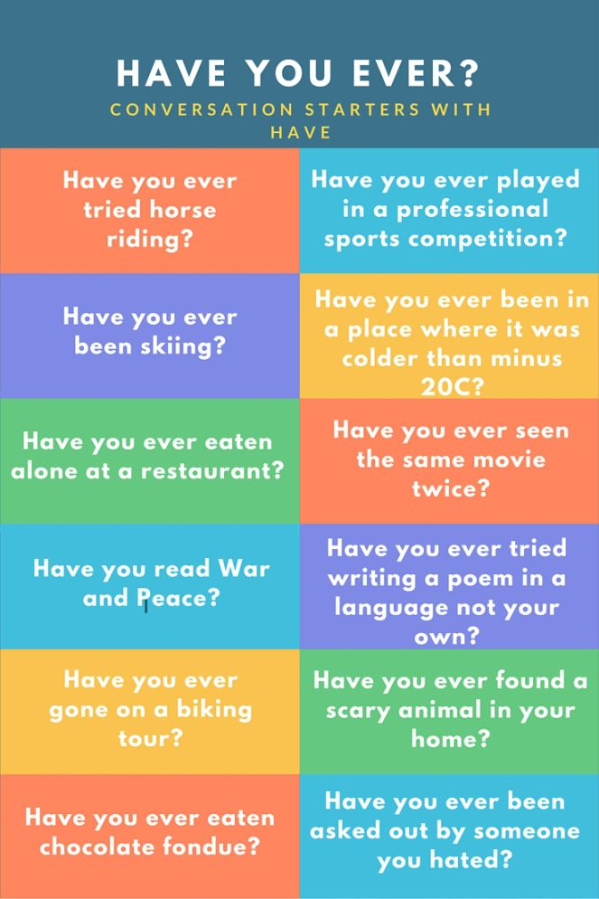
Have you ever…
Have you ever meaning any time in your life until now
Have you ever been to Paris - Yes I have. Did you have a good time? - Yes I did.

Slide 14
12C Have a good trip
Vocabulary
Return flight – povratni let
Boarding card – bording karta
City break – a short holiday in a famous city
Car hire – iznajmiti auto
Passport – pasoš

Slide 15
Vocabulary
Hand luggage – ručni prtljag
Sharp items – oštr predmeti
Passengers – putnici
A ticket – karta
Pack your bags – spakovati stvari

Slide 16
Vocabulary
A flight number – broj leta
A check in desk – šalter za prijavljivanje
Scissors – makaze
a window – prozor
Backpack – ruksak
On time – na vrijeme (at the planned time) Trip – putovanje (when you travel to a place and come back again)
Journey – putovanje (one direction only)

Slide 17
Travel expressions
Have a nice weekend. Have a nice holiday. Have a good trip.
See you in two weeks. See you next year. See you on the next course.
Send me an e-mail.
Send us a postcard.

Slide 18
Review
Uraditi 12 Review, strana 100

Slide 19
Review
Complete the worksheet using the correct comparative or superlative.
1) Canada is __________ than China but Russia is the ____________ country.
a) big b) bigger c) biggest
2) Monkeys are ____________ but ants are ____________.
a) small b) smaller c) smallest
3) Giraffes are the __________ land animal.
a) tall b) taller c) tallest
4) Boys usually have ___________ hair than girls.
a) short) shorter c) shortest
5) Lamps are ___________ but the sun is ____________.
a) bright b) brighter c) brightest .

Slide 20
Review
Comparative Superlative
Popular
Hot
Difficult
Young
Slim
Interesting
Sad
Bad
Easy
Strong
Cold
Pretty
Intelligent
Good
Quiet
Narrow
Old
Far
Tall
High
Cheap
Dangerous
Comparative Superlative
Expensive
Beautiful
Deep
Fat
Modern
Silly
Noisy
Amazing
Busy
Famous
Simple
Funny
Important
Short
Crazy
Nervous
Spicy
Handsome
Early
Nice
Generous
Ugly

Slide 21
THANK YOU

