Slide 1
4 Time off
4A Away from home
1

Slide 2
Vocabulary
Go swimming – ići na plivanje
Watch – gledati
Take photos – fotografisati
Read books – čitati knige
Play tennis – igrati tenis
Go skiing – ići na skijanje
Go running – ići na trčanje

Slide 3
Vocabulary
Listen ti the radio - slušati radio
Watch DVDs and videos
Go dancing – ići na ples
Listen to music – slušati muziku
Watch sport on TV

Slide 4
Present Simle spelling rules
Regular spelling |  | Singular | The third person singular
-s in most cases |  | work | s/he works
 |  | drive | s/he drives
 |  | play | s/he plays
 |  | run | s/he runs
-es when a verbs ends with: | -o | do | s/he does
 | -ss | miss | s/he misses
 | -x | mix | s/he mixes
 | -ch | catch | catches
 | -sh | push | pushes
consonant + -y turns into | -ies | cry | s/he cries
 |  | fly | s/he flies
vowel + -y takes -s | -s | buy | buys
 |  | say | says
 |  | obey | obeys

Slide 5
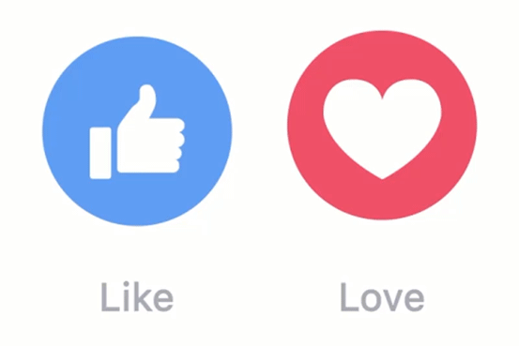
4B First date!
3. I quite like
Ja prilično volim
1. I love
Ja volim
2. I really like
4. I like
Ja veoma volim
Dopada mi se

Slide 6

4B First date!
7. I hate
Ja mrzim
5. ... is/are OK.
.... je/su OK.
6. I don’t like
Ne dopada mi se

Slide 7
Vocabulary
Shopping for clothes – kupovina odjeće
reading – čitanje
Travelling – putovanje
Football – fudbal
Cats – mačke

Slide 8
Vocabulary
Dancing – igranje
Chinese food
Computer games – kompjuterske igrice
Animals – životinje
Cooking – kuvanje

Slide 9
Present Simple questions
Auxiliary | Subject | Verb | Rest | Yes/No | Subject | Auxiliary (+ n't)
Do | you | read | books? | Yes, No, | I I | do. don't.
Does | Peter | play | football? | Yes, No, | he he | does. doesn't.
Question word | Auxiliary | Subject | Verb | Rest | Answer
What | do | you | play | on your computer? | I play games on my computer.
When | does | your mother | go | to work? | She goes to work at 6 o'clock.
Where | do | you | meet | your friends? | I meet them at the bus stop.

Slide 10
4C Eating out
Vocabulary
A coffee – kafa
A glass of red wine – čaša crvenog vina
A bottle of beer – boca piva
Chicken salad – salata sa piletinom
A cheese and tomato sandwich – sendvič sa sirom i paradajzom
Mineral water – mineralna voda
A mixed salad – miješana zelena salata

Slide 11

How much / What’s that
What’ s that?
Šta je to?
How much is...
Koliko je..
How much is tuna salad?
What’ s that?
Koliko novca je salata od tune?
A chese and tomato sandwich.

Slide 12
Offers
Would you like to order now?
Da li bi želio da naručiš sada?
Would you like red or white?
Da li bi željela crno ili bijeo?
Would you like anything else?
Da li želiš još nešto?
Šta bi želio da piješ?
I’d like=want (želim)
I like=things we like in general (stvari koje volimo u globalu)

Slide 13
Requests
We’d like a tuna salad.
Željeli bi salatu od tune.
I would like a glass of wine.
Željela bih čašu vina.
We’d like = We would like

Slide 14
4D Breakfast time
Vocabulary
Bread – hleb
Milk – mlijeko
Rice – riža
Biscuits – biskviti
An apple – jabuka
Toast – tost
Sausages – kobasice

Slide 15
Vocabulary
Jam – dzem
Eggs – jaja
A banana – banana
Fish – riba
Meat – meso
Vegetables – povrće
Tea – čaj

Slide 16
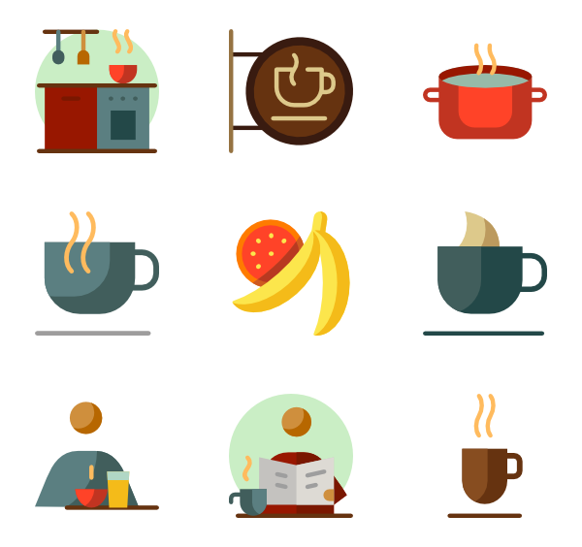
Vocabulary
Have breakfast – doručkovati
Have coffee – piti kafu
Cook – kuvar
To cook - kuvati

Slide 17
Countable and Uncountable nouns
COUNTABLE NOUNS
Countable nouns are for things we can count using numbers. They have a singular and a plural form. The singular form can use the determiner "a" or "an". If you want to ask about the quantity of a countable noun, you ask "How many?" combined with the plural countable noun. We use A or AN with singular countable nouns. We don’t use A or An with plural countable nouns.
Singular | Plural
one dog | two dogs
one horse | two horses
one man | two men
one idea | two ideas
one shop | two shops

Slide 18
Countable and Uncountable nouns
UNCOUNTABLE NOUNS
Uncountable nouns are for the things that we cannot count with numbers. They may be the names for abstract ideas or qualities or for physical objects that are too small or too amorphous to be counted (liquids, powders, gases, etc.). Uncountable nouns are used with a singular verb. They usually do not have a plural form. We don’t use A or AN with uncountable nouns.
EXAPLES
tea
sugar
water
rice
knowledge
Beauty
fear
love
money
safety
evidence

Slide 19
Review
Uraditi 4 Review, strana 37

Slide 20
Review
A Add -s, -es or -ies to the verbs below to form the Present Simple for he, she or it.
1 stop ......................
2 watch ......................
3 study ......................
4 do ......................
5 mix ......................
6 tie ......................
7 dress ......................
8 try ......................
9 go ......................
10 catch ......................
11 enjoy ......................
12 lose ......................
B Complete the sentences with the Present Simple form of the verb in brackets.
1 Mum ...................... (wash) the car once a week.
2 Children usually ...................... (like) ice cream. to France.
3 ...................... you ...................... (know) the way
4 Bob ...................... (study) French on Saturdays.
5 Every year Helen ...................... (go)

Slide 21
Review
C Write each sentence in the negative. Then write an affirmative sentence using the words in
brackets.
1 You need more spelling practice. (reading)
a ...................................................................
b ...................................................................
2 My dad reads the newspaper every day. (a book)
a ...................................................................
b ...................................................................
3 I study on Saturdays. (Sundays)
a ...................................................................
b ...................................................................
4 Mark goes to karate lessons. (piano)
a ...................................................................
b ...................................................................
D Write questions and answer them about yourself.
1 your grandma / often / visit you / ? 3 your dad / play / the guitar / ?
................................................................... ...................................................................
................................................................... ...................................................................
2 you / watch / TV / in the evening / ? 4 your friends / like / computer games / ?
................................................................... . ..................................................................
................................................................... ...................................................................

Slide 22
Review
3. ride / their / bicycles / to work / every day
_________________________________________
_________________________________________
_________________________________________
go work ride deliver love jog rest fish walk
4. listen / to the radio / every Sunday
_________________________________________
_________________________________________
_________________________________________

Slide 23
Answers
A 1 stops 5 mixes 9 goes
2 watches 6 ties 10 catches
3 studies 7 dresses 11 enjoys
4 does 8 tries 12 loses
B 1 washes 4 studies
2 like 5 goes
3 Do ... know 6 doesn’t visit
C 1 a You don’t need more spelling practice.
b You need more reading practice.
2 a My dad doesn’t read the newspaper every day.
b My dad reads a book every day.
3 a I don’t study on Saturdays.
b I study on Sundays.
4 a Mark doesn’t go to karate lessons.
b Mark goes to piano lessons.
D 1 Does your grandma often visit you?
Yes, she does. / No, she doesn’t.
2 Do you watch TV in the evening?
Yes, I do. / No, I don’t.
3 Does your dad play the guitar?
Yes, he does. / No, he doesn’t.
4 Do your friends like computer games?
Yes, they do. / No, they don’t.

Slide 24
THANK YOU

