Slide 1
5A Keeping koi
Vocabulary: animals
Grammar: ways of comparing
Review: saying you are surprised or not surprised

Slide 2
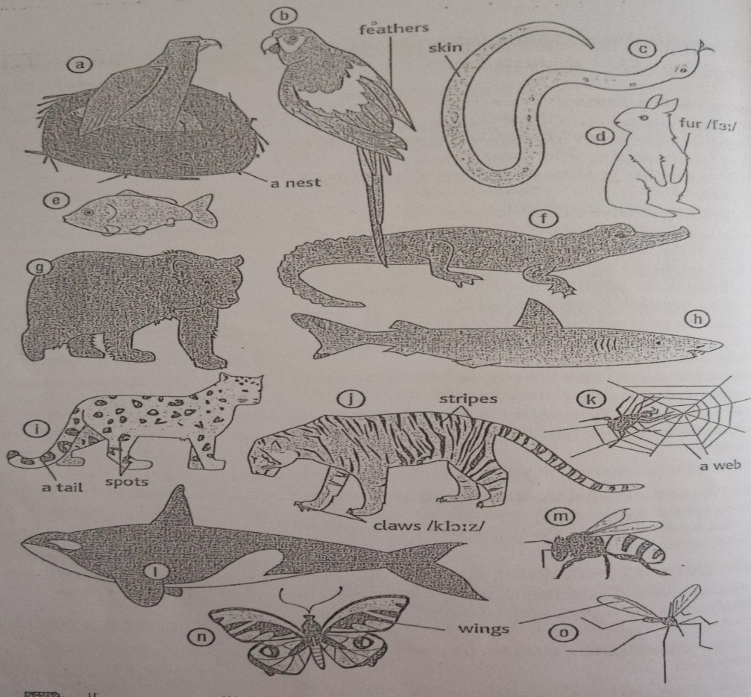
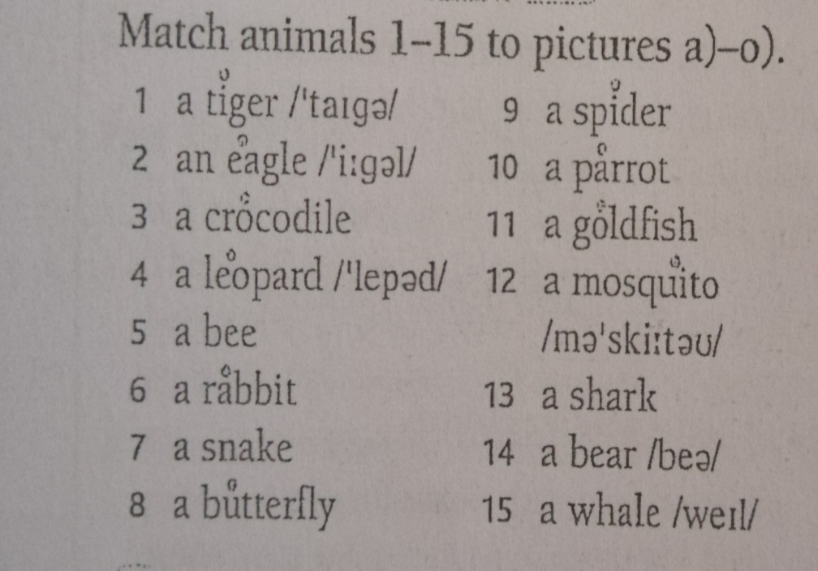
Vocabulary In module 5 we are going to deal with Nature Happy Earth Day ( April 22nd )
Animals

Slide 3
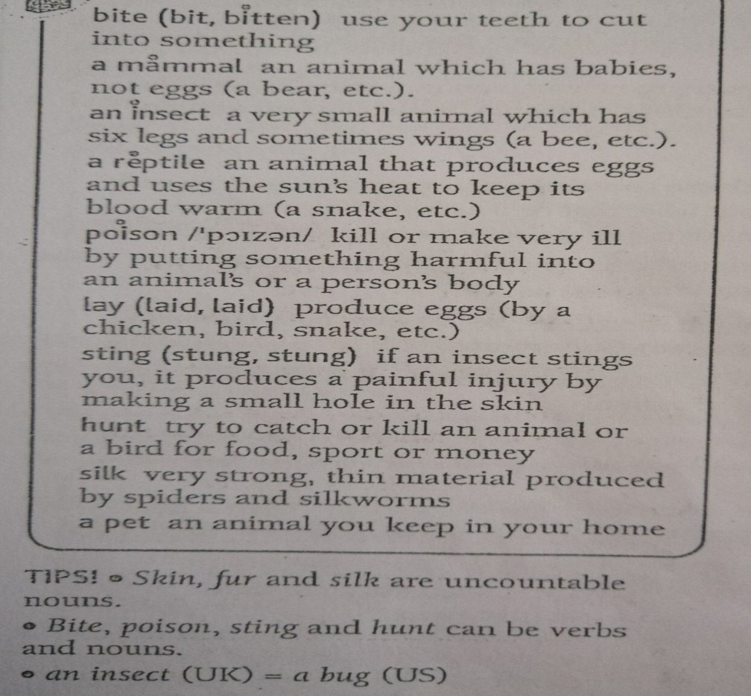
Here are some new vocabulary connected to animal world
Let’ try to do exercise 1 b) together
This animal….
…is a fish that can bite- shark.
…is a mammal that lives underwater-whale.
…is a bird with colorful feathers-parrot.
…is an insect with wings- bee, wasp, mosquito or butterfly.
…is a reptile that can poison you-snake.
…has stripes and a long tail-a tiger
…has spots and sharp claws- leopard.
…builds a nest to lay its legs in it-an eagle.
…has a fur and lives underground-rabbit.
…makes honey and can sting you-bee.
…makes a web out of silk-a spider
…is often kept as a pet- goldfish, parrot…

Slide 4
Reading and grammar
Keeping Koi
Ways of comparing
koi (n)- a common carp of a large ornamental variety, originally bred in Japan.
Try to answer the questions in exercise 2, then read the text on page 39. and try to answer the questions
1) Why are koi such unusual pets?
2) Did the writer buy any koi? Why/why not?
What does the article say about numbers 89, 10 000, 250 000, 15 000, 75 and 5?
Comparation is the formation of the comparative and superlative forms of adjectives and adverbs. Here are some ways of expressing:
Big difference
Small difference
No difference

Slide 5
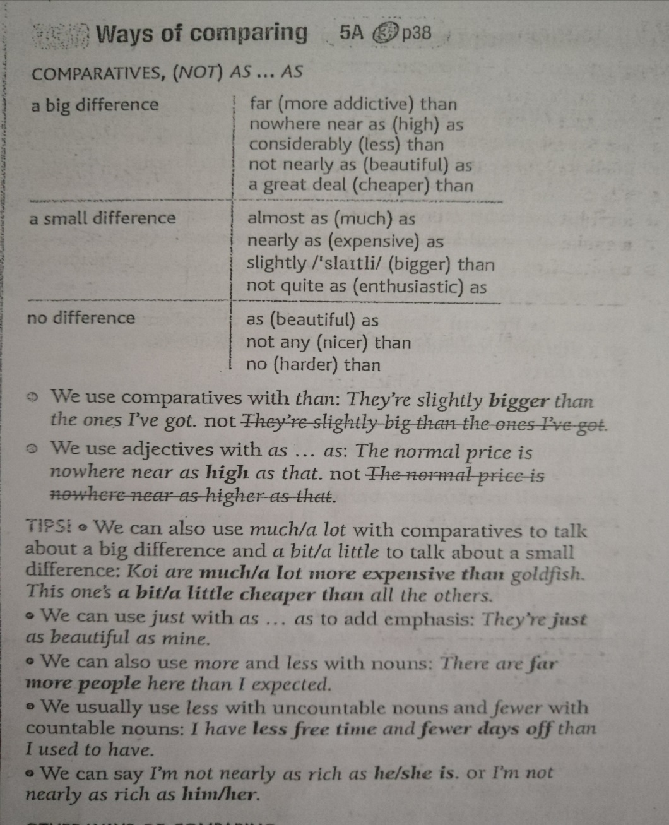
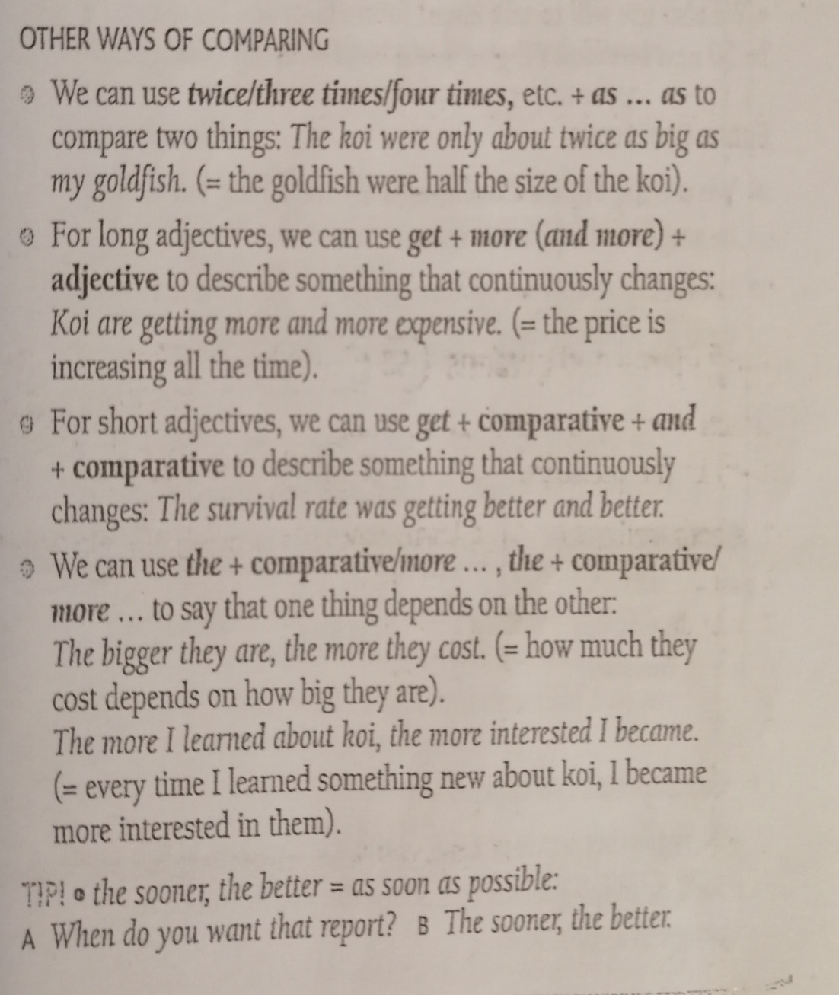

Slide 6
Comparison and contrast are expressed by the use of the…the… with comparative adjectives in parallel clauses. This structure is used to show proportionate increase or decrease.
Structure: the + comparative adjective + clause + the + comparative adjective + clause
The more adventurous it is, the more I like it. (NOT The more it is adventurous, the more I like it.)
The less I see him the more I like him.
The more he reads, the less he understands.
The older we grow, the wiser we become.
The higher you climb, the colder it gets.
The richer one grows, the greater one’s worries.
The less you spend, the more you save.
The sooner they go, the better it is.
A short form of this structure is used in the expressions ‘the more the merrier’ and ‘…the better’.
‘How do you like your coffee?’ ‘The stronger the better.’
‘When should I start?’ ‘The earlier the better.’

Slide 7
Now, using tips and help with grammar, please try to do exercises 5, 6, 7 and 8.
pp.38/39 as well as workbook pp. 25/26.
If you have any questions connected to online material please contact me on my mail!
’’Stay positive, stay curious’’- Stay healthy, Stay home!

