Slide 1
5 Homes and shops
5A My kind of place
1

Slide 2
5A My kind of place
Vocabulary
A lake –jezero
A park – park
Bus station – autobuska stanica
A square – trg
A market – pijaca
Train station – autobuska stanica
A beach – plaža

Slide 3
Vocabulary
The sea – more
A museum – muzej
A road - put
A flat = apartment
stan
A river – rijeka
An airport – aerodrom
A bar – kafic

Slide 4
Vocabulary
A building – zgrada
B&B – bed and breakfast
A pub - pab
A hotel – hotel
A shop - prodavnica

Slide 5
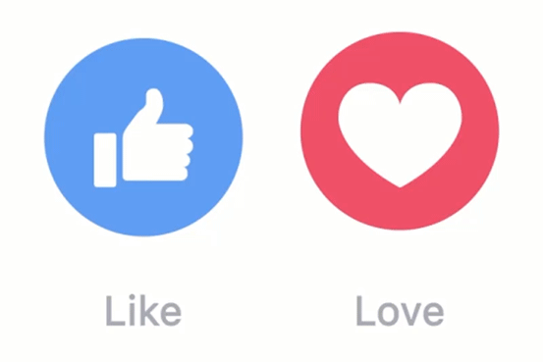
There is / There are
There is a lake.
Tamo je jezero.
It’s beautiful.
Prelijepo je.
There are two hotels.
Tamo ima dva hotela.
They are expensive.
Oni su skupi

Slide 6
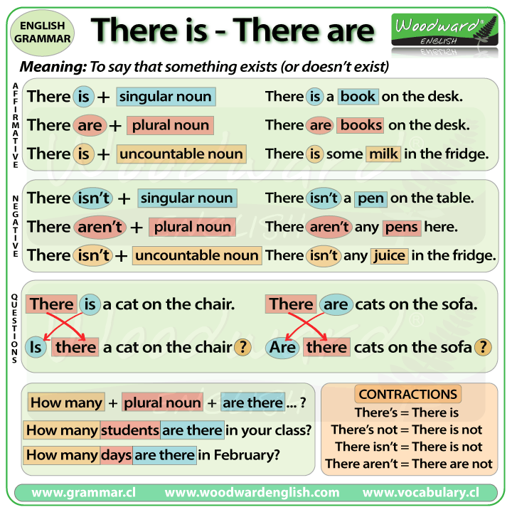
There is / There are

Slide 7
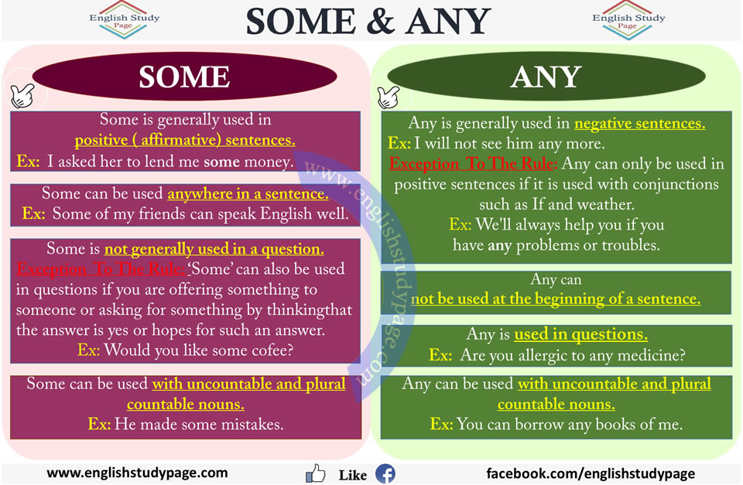
Some and Any
*We use A or An in positive sentences, negative and questions with singular countable nouns.

Slide 8
5B Renting a flat
Vocabulary
Furniture – namještaj
A refrigerator = fridge – frižider
A shair -stolica
A single room – jednokrevetna soba
A shower - tuš
A double bed – francuski krevet
A bath – kupatilo

Slide 9
Vocabulary
An armchair – fotelja
A plant – biljka
A washing machine – mašina za veš
A cooker – šporet
A desk – stol
A sofa – sofa
Washbasin = sink –lavabo

Slide 10
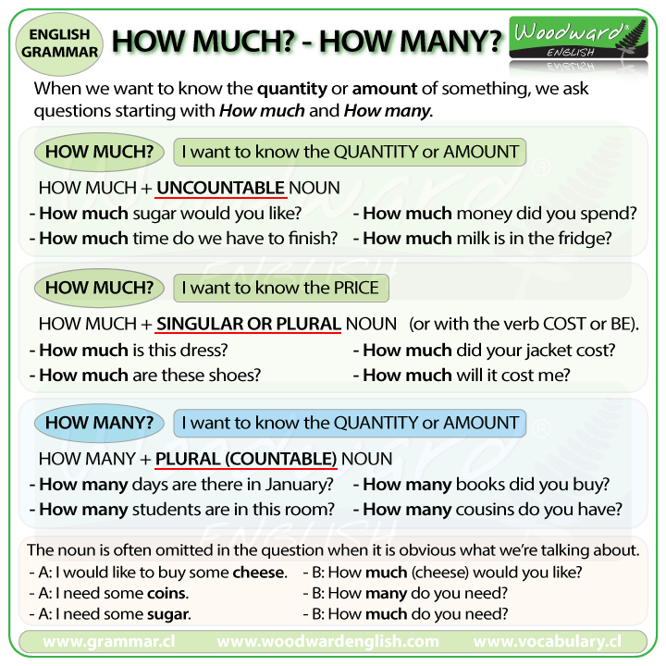
How many / How much

Slide 11
5C At the shops
Vocabulary
A kiosk – kiosk
A bookshop – knjižara
A dry cleaner – hemijska čistiona
A supermarket
A bank – banka
A chemist’s = chemist’s shop = pjarmacy – apoteka
A newsagent’s – prodavnica novina

Slide 12
Vocabulary
A baker’s – pekara
Greengrocer’s – zelena pijaca
Dictionary – rječnik
A butcher’s – mesara
A department store – robna kuća
Post office – pošta
Cigarettes – cigarete

Slide 13

One and Ones
This one
Ova ovdje?
How much is this sofa?
Koliko je ova sofa?
A kilo of apples, please.
The green ones?
Kilogram jabuka, moliću Vas.
Ove zelene?
We use ONE in place of singular noun.
We use ONES in place of plural noun.

Slide 14
Vocabulary
A map – mapa
Batteries – baterije
Envelope – koverta
Stamps – markice
Phone cards – telefonske kartice
A film – film
Postcards – razglednice

Slide 15
Vocabulary
A magazine – časopis
A bottle of water – boca vode
Chocolate – čokolada
Tussues – maramice
A lighter - upaljač
A newspaper – novine
Batteries – baterije

Slide 16
5D In fashion
Vocabulary
A suit – odijelo
Shorts – šorts
A dress – haljina
A trousers – pantalone
Jeans – farmerice
Shoes – cipele
A skirt – suknja

Slide 17
Vocabulary
Boots – čizme
Trainers – patike
A hat – kapa/šešir
A jumper – dzemper
A shirt – košulja
A jacket – jakna
A tie – kravata

Slide 18
Vocabulary
Socks – čarape
A top – top
A cap – kačket
A T-shirt – majica
A coat – kaput

Slide 19
Vocabulary
Words like jeans / shorts look plural and take plural verb (are) but actually one thing. We cannot say jean, we say jeans.
Words like shoe / sock are plural words and refer to a two shoes / two socks. But we can say 1 shoe / 1 sock.
We can use a pair of... (par) with both types of plural nouns.
I’ve got a new pair of jeans / trousers / shoes...
The word clothes (odjeća) is always plural. If we want to use singular form, we can say an item of clothing (odvojeni predmet).

Slide 20
Review
Uraditi 5 Review, strana 45

